Slide 1
Wellness Manager
Project
Marvin Jakobs

Slide 2
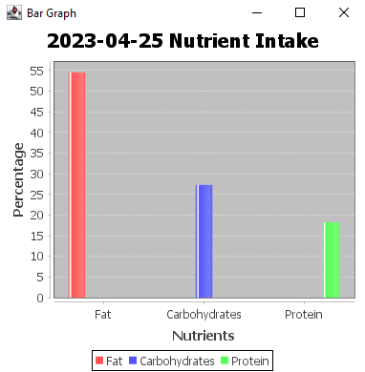
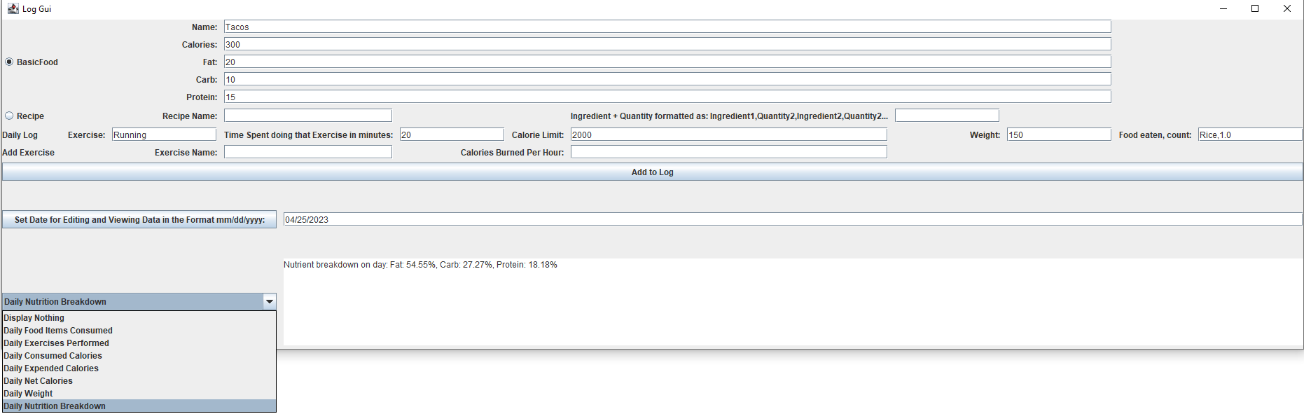
Interface
Simple single view GUI for interacting with program
Allows adding foods, recipes, and exercises and Logging daily workouts and food eaten on any day
Dropdown menu for displaying different statistics
Popup of Nutrient breakdown for chosen day

Slide 3
Data Displays

Slide 4
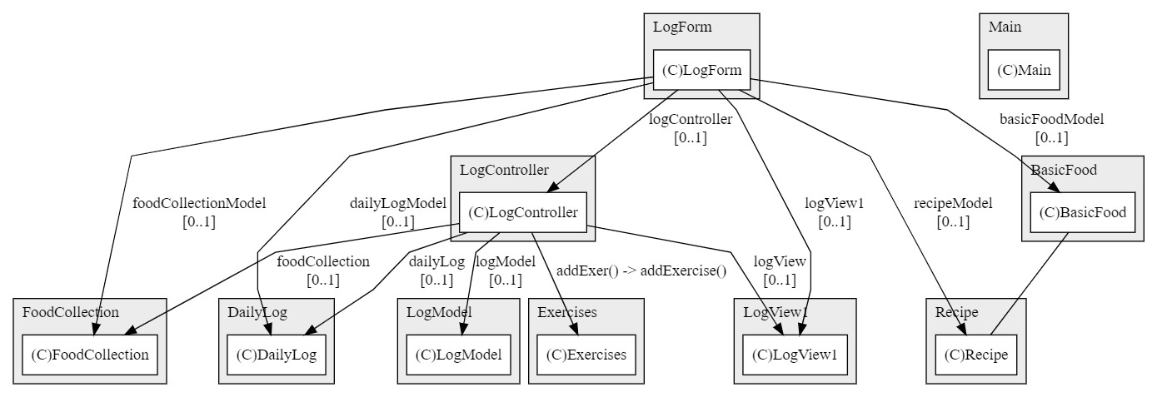
Model View Controller Pattern
LogForm: View
LogController: Controller
Exercises, DailyLog, FoodCollection: Models
Controller communicates with models and view
Modular and maintainable code

Slide 5
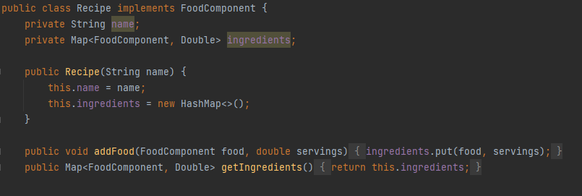
Composite Pattern
Implemented in Recipe class
FoodComponent as interface
Map of FoodComponent objects and quantities
addFood() method handles BasicFood and Recipe instances
Recipe class treated as composite object

Slide 6
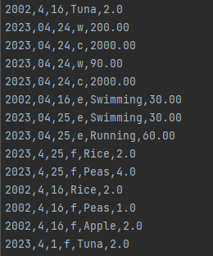
Memento Pattern
Captures and restores object state
Used in DailyLog, FoodCollection, and Exercises
Loading CSV data as memento implementation
Separation of state and behavior
Easier code maintenance

Slide 7
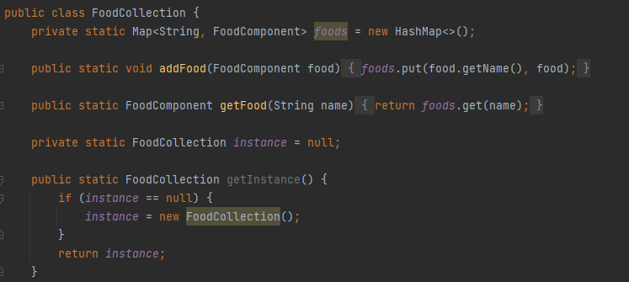
Singleton Pattern
Ensures single instance of DailyLog and FoodCollection classes
Private constructors, public static methods
Used in LogModel class
Maintains consistency and avoids conflicts

Slide 8
Mediator Pattern
LogController acts as a mediator between View and Models
LogController processes data and updates relevant models
Ensures decoupling and independence of view and models
Separation of concerns makes updating easier
Makes testing and debugging easier.

Slide 9
Design Patterns Effects
Wellness Manager program uses multiple design patterns
Composite, MVC, Memento, Mediator, and Singleton patterns
Increases modularity, maintainability, and flexibility
Efficient for future maintenance and updates

Slide 10
Demo!

Slide 11
Thanks
Questions?

